Slide 1
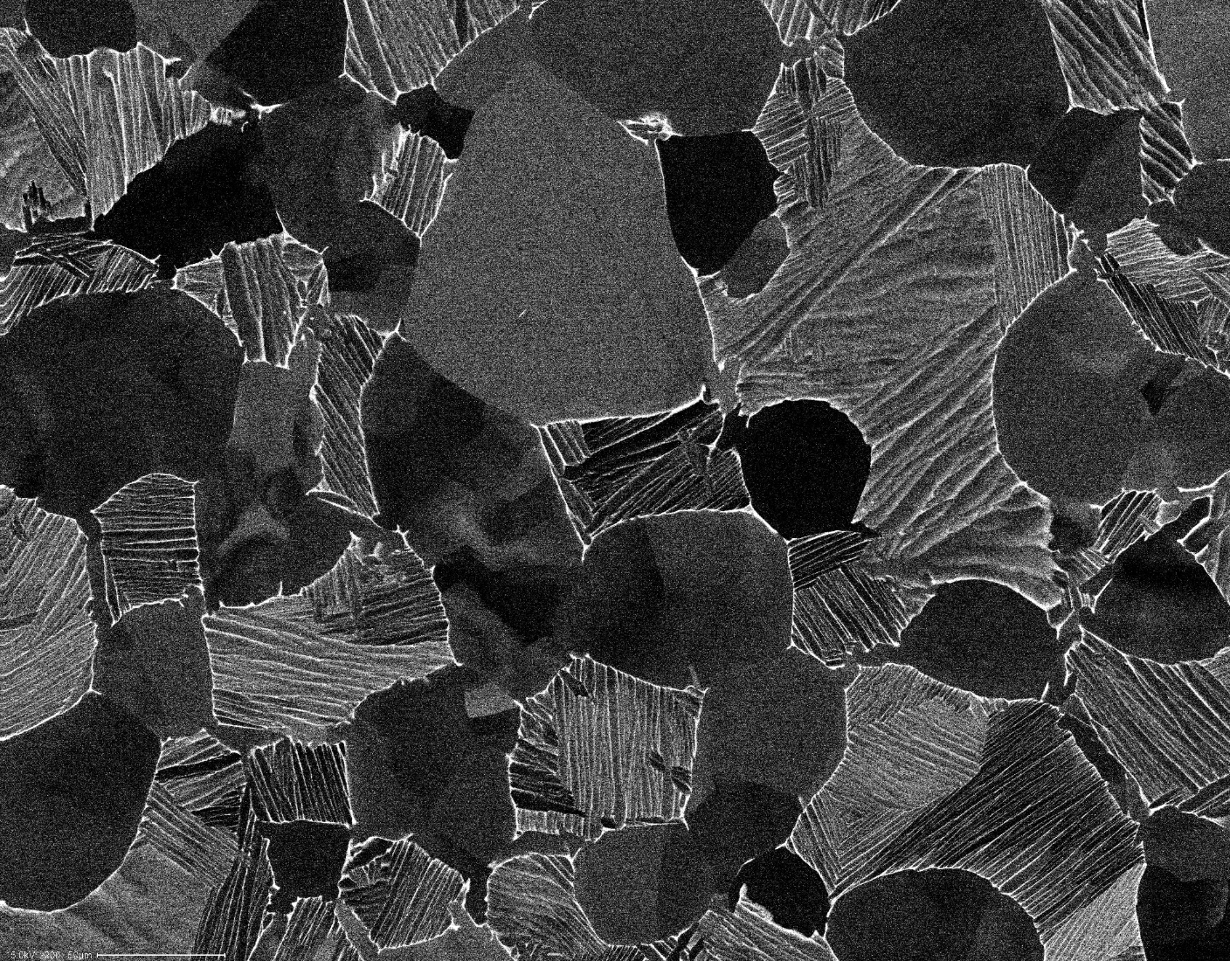
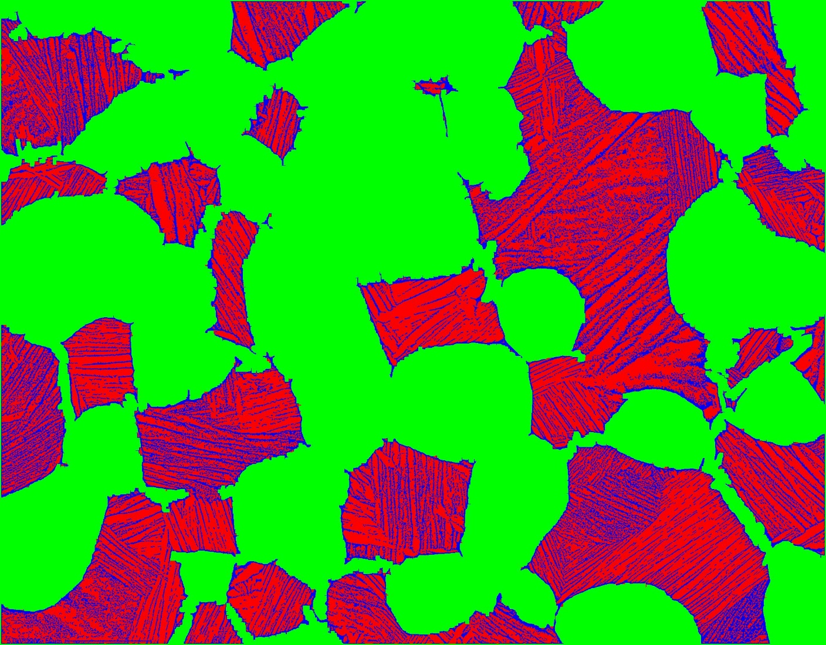

Slide 2
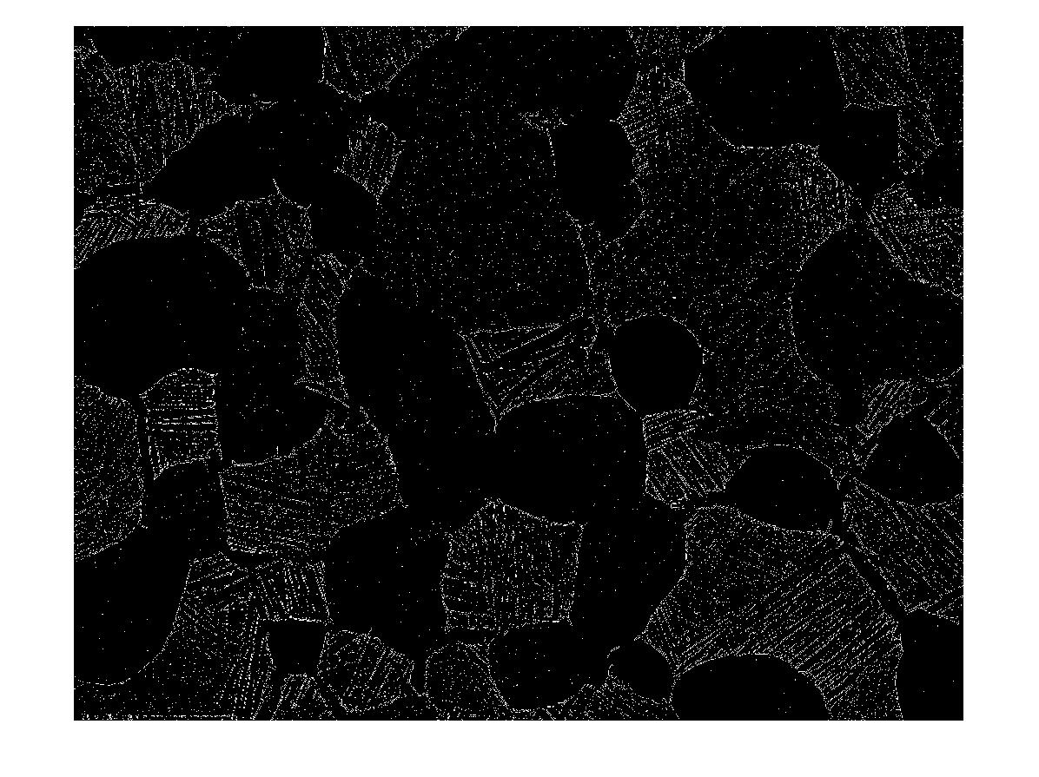
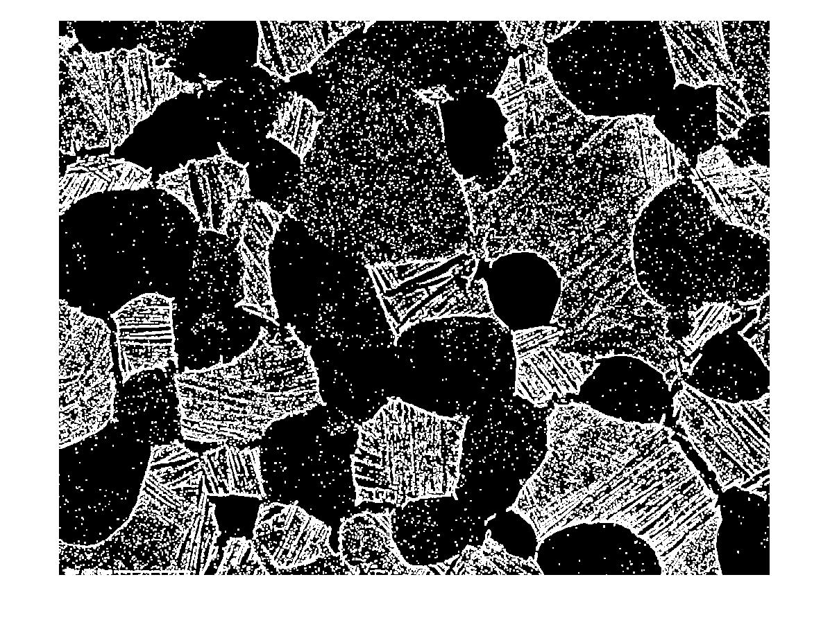
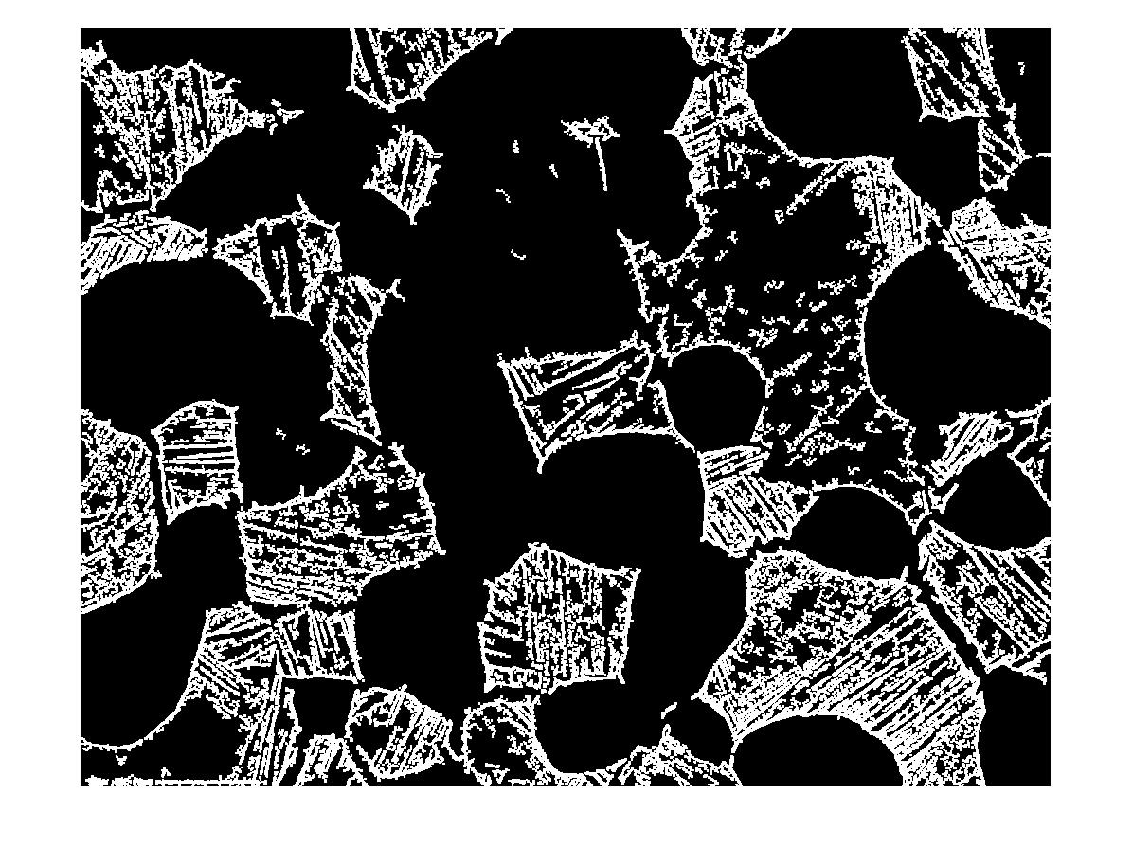
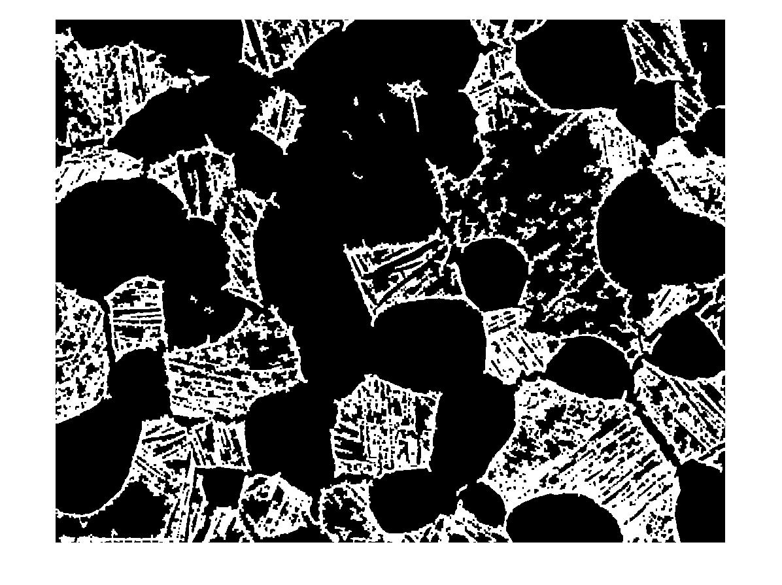
clear; close all;
fname=('1000C5hAC_800x');
i = imread(sprintf('%s.tif',fname));
[h, w] = size(i);
%% find edge (Sobel method)
e= edge(i);
%% grow edges
d= imdilate(e,strel('disk',3));
%% remove less than 200 pixel
op= bwareaopen(d,200);
%% Fill lamellae (close edges)
cl= imclose(op,strel('disk',3));
%% fill white (closed) grain
rm= ~bwareaopen(~cl,150000);

Slide 3
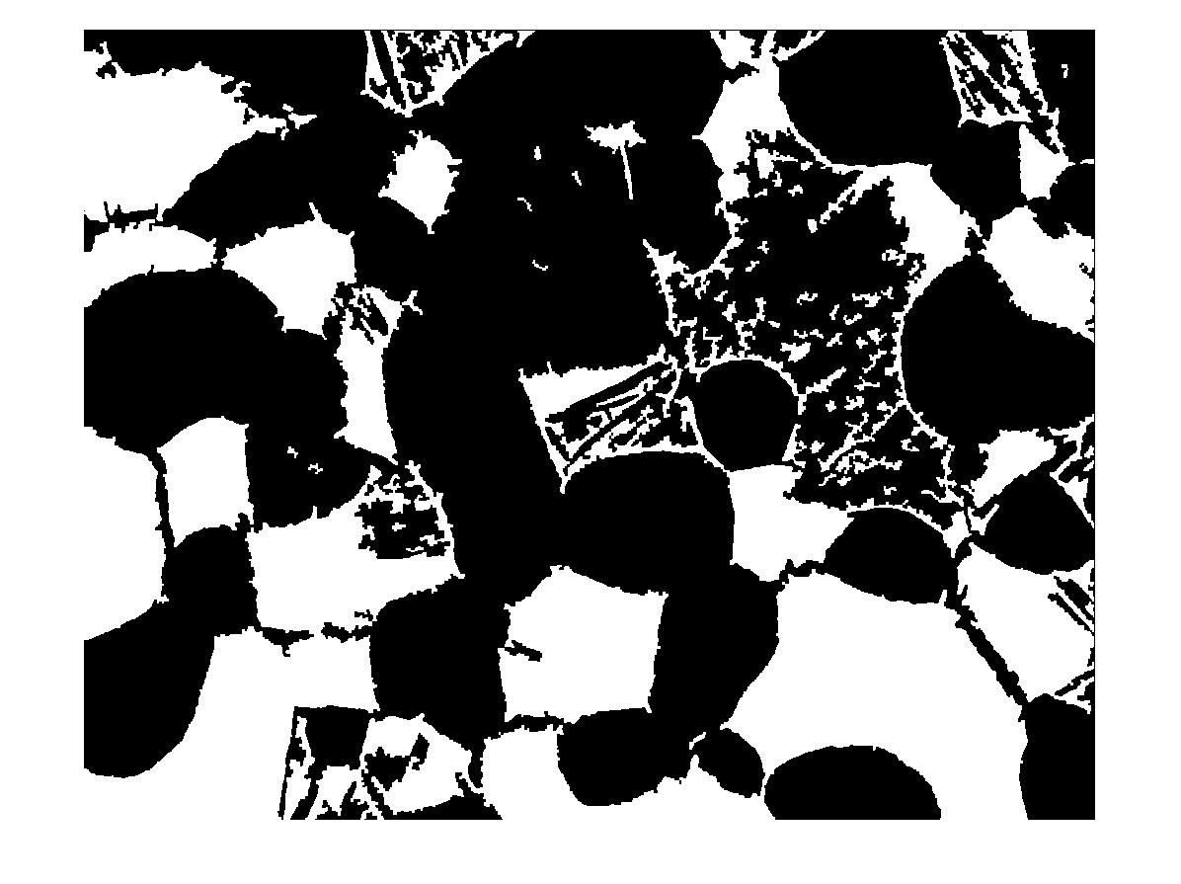
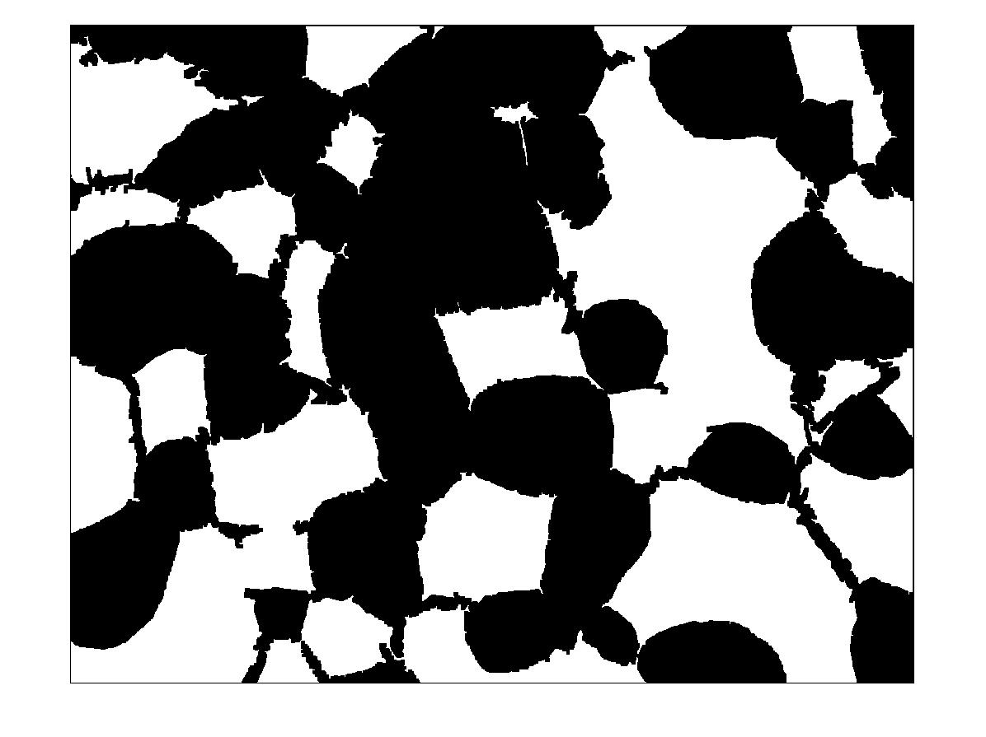
Manual closing of the edges
%% fill white (closed) grain
rm= ~bwareaopen(~cl,150000);
%% Erosion
G= imerode(F,strel('disk',4));
%% remove less than 200 pixel
H= bwareaopen(G,200);

Slide 4
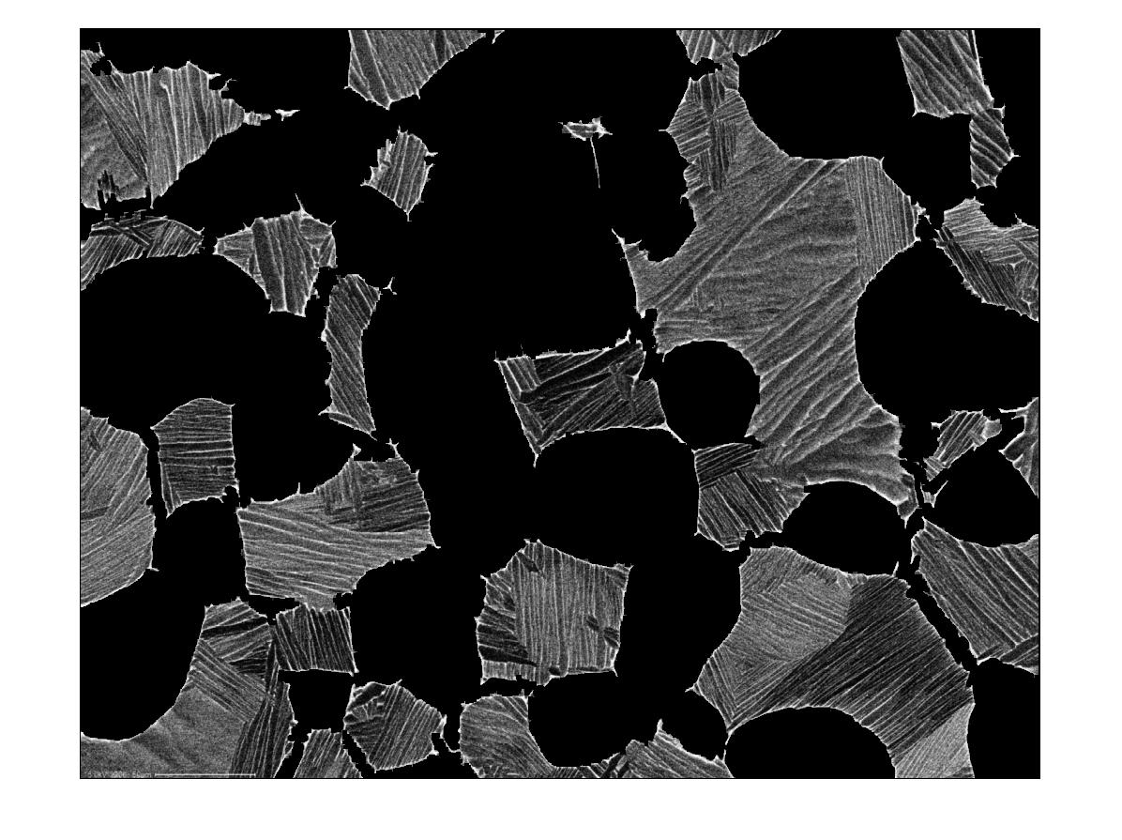
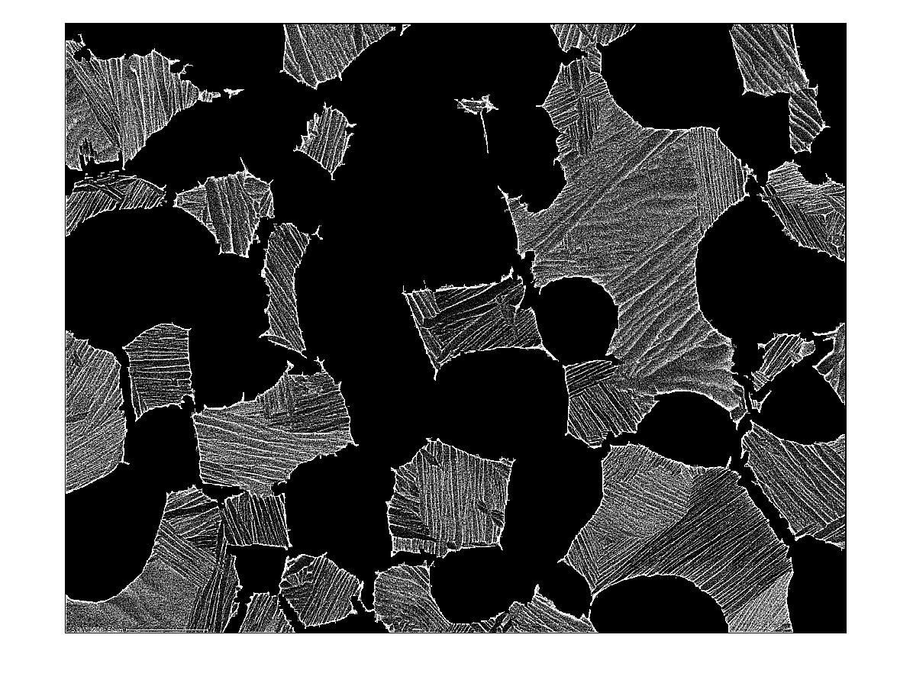
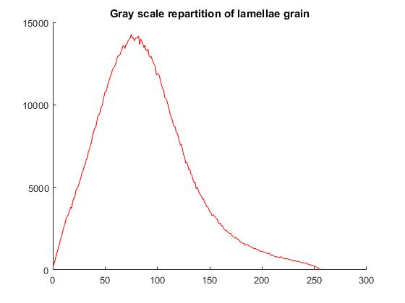
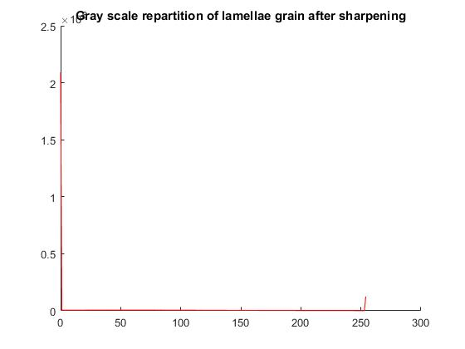
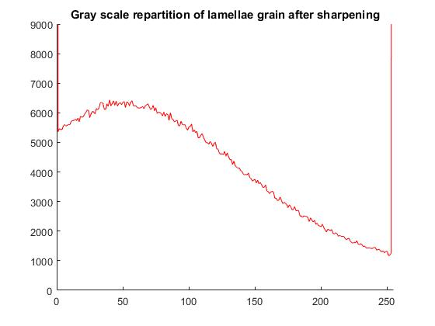
[H]
%% Gaussian smoothing of initial image
a = imgaussfilt(i,1);
%% 0 value for α phase
a(~H)=0;
%% Sharpening of the β and α2 phase
amount=8;
Sa = imsharpen(a,'amount',amount);

Slide 5
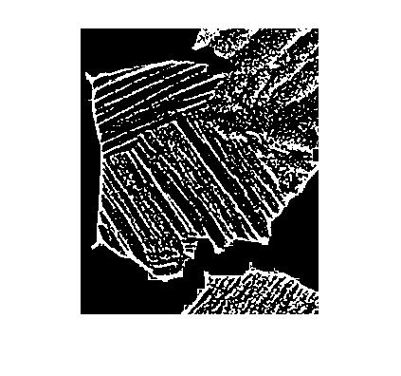
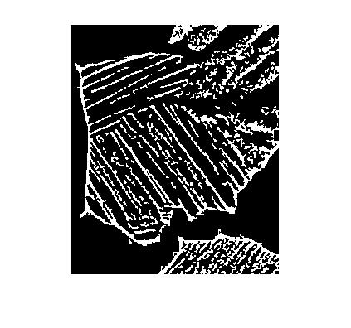

%% Masking of alpha phase (NaN)
Sa_NaN=double(Sa);
Sa_NaN(~H)=NaN;
% threshold on remaining β and α2
Sa_nonans=Sa_NaN(~isnan(Sa_NaN(:)));
counts = grscrep(Sa_nonans,size(Sa_nonans),1);
t = otsuthresh(counts(2,:))*255;
Salpha1 = H==0;
Salpha2 = Sa_NaN<=t;
Sbeta = Sa_NaN>t;
%% Remove small α2 and β dot
SbetaN = ~bwareaopen(~Sbeta,10);
SbetaN = bwareaopen(SbetaN,10);
% delete alpha 2 that are now beta
Salpha2N = ~(Salpha1 + SbetaN );
%% Save three phases as a tiff file
SFinalSegN =zeros(h,w,3);
SFinalSegN(:,:,1)=Salpha2N;
SFinalSegN(:,:,2)=Salpha1;
SFinalSegN(:,:,3)=SbetaN;
imwrite(SFinalSegN,sprintf('%s_Segmented(shap8)_NoNaNs.tif',fname));

Slide 6

Volume fraction (%)
α | 56.6
β | 14.03
α2 | 29.37

